Slide 1

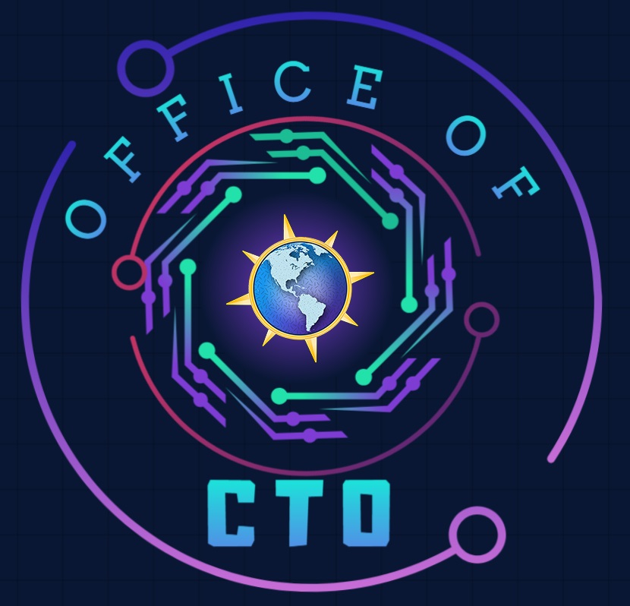

Microsoft Microhack
Agentic AI
Presented by
Americas Office of the CTO

Slide 2
Agenda
Welcome & Introduction | 10 mins | 11:00 – 11:10 A.M. (EST)
Setting the Stage | 40 mins | 11:10 – 11:50 A.M. (EST)
Lunch | 30 mins | 11:50 – 12:20 P.M. (EST)
Hands-On Hack | 60 mins | 12:20 – 1:20 P.M. (EST)
Break | 10 mins | 1:20 – 1:30 P.M. (EST)
Hands-On Hack | 60 mins | 1:30 – 2:30 P.M. (EST)
Show & Tell | 45 mins | 2:30 – 3:15 P.M. (EST)
Close | 15 mins | 3:15 – 3:30 P.M. (EST)

Slide 3

Welcome & Introductions
1

Slide 4
Agenda
Welcome & Introduction | 10 mins | 11:00 – 11:10 A.M. (EST)
Setting the Stage | 40 mins | 11:10 – 11:50 A.M. (EST)
Lunch | 30 mins | 11:50 – 12:20 P.M. (EST)
Hands-On Hack | 60 mins | 12:20 – 1:20 P.M. (EST)
Break | 10 mins | 1:20 – 1:30 P.M. (EST)
Hands-On Hack | 60 mins | 1:30 – 2:30 P.M. (EST)
Show & Tell | 45 mins | 2:30 – 3:15 P.M. (EST)
Close | 15 mins | 3:15 – 3:30 P.M. (EST)
Notes:
Welcome & Intro – Dave
Setting the Stage - James & Lali
Show & Tell - Amul

Slide 5

Microhack Goals
We build technical skills through hands-on application in key areas, while fostering a sense of community and collaboration.
Make it Real Learning: Hands-on experience that translates directly to customer solutions
Leverage Key Resources: Access essential tools and demos for continuous learning.
Deepen Expertise: Build critical technical skills in priority areas
Collaborative Learning: Work with peers and experts in a team-driven setting
Lasting Impact: Equip teams to deliver more value and innovation to customers
Join our Microhack Community | MicrohackCommunity@microsoft.com
Notes:
Dave

Slide 6
Setting the Stage
2

Slide 7
Agenda
Welcome & Introduction | 10 mins | 11:00 – 11:10 A.M. (EST)
Setting the Stage | 40 mins | 11:10 – 11:50 A.M. (EST)
Lunch | 30 mins | 11:50 – 12:20 P.M. (EST)
Hands-On Hack | 60 mins | 12:20 – 1:20 P.M. (EST)
Break | 10 mins | 1:20 – 1:30 P.M. (EST)
Hands-On Hack | 60 mins | 1:30 – 2:30 P.M. (EST)
Show & Tell | 45 mins | 2:30 – 3:15 P.M. (EST)
Close | 15 mins | 3:15 – 3:30 P.M. (EST)

Slide 8





Microsoft Microhack
Agentic AI
Overview
Hack
Break
Show & Tell
Closing
Outline the Microhack experience, review customer scenario and related technologies.
Participants will work in teams to complete hands-on lab by tackling a series of challenges.
Break for all participants.
Teams will take turns providing a presentation to showcase their accomplishments and methods during the Microhack.
Review of Microhack accomplishments and guide the participants for continuing their journey.
1
2
3
4
5
60 minutes
110 minutes
10 minutes
45 minutes
15 minutes
You are HERE

Slide 9
Microsoft Microhack
What you will be working on:
Microsoft Teams – use to collaborate with your Microhack team
Copilot Studio – Microhack development environment #1
Azure – Microhack development environment #2
Microhack Challenges packet – complete challenges to complete Microhack successfully
Copilot Studio (GUI)
Azure AI Foundry (GUI)
Azure AI Foundry (Code-First)
Who you will be working with:
Join your assigned team of 3-7 participants
Join your Teams Break-Out channel
Coaches available to help
Main channel will display schedule and remain open for coach requests.
Share Challenge completion updates in Main Teams channel

Slide 10
Rules of Engagement
Dos
Invest in yourself. This is your training and your dedicated time for training. Make the most of it.
Contribute to the team.
You can finish in the time allotted, but you will need the time and group collaboration in order to finish.
Share completion information in the main team channel.
Don’t
Leave your team for extended periods of time.
Give up (ask if you need help).

Slide 11
Customer Scenario | Contoso
Who is Contoso?
Outdoors sporting goods company
Enormous product portfolio
Rapidly growing product ecosystem
Extensive product sales data in relational store
What is Contoso trying to accomplish?
Consolidate product catalog
Streamline and modernize product documentation
Increase ease-of-use of products catalog understanding
Increase ease-of-use of products sales data

Slide 12
What is Agentic AI?
Agents that use AI to automate and execute business processes, nearly autonomously. They can plan and adapt to new information and act on tasks independently.

Slide 13



AI Agents
Reasoning over the request
Unlike existing automation, AI Agents can automate requests as soon as they come in by…
Proactively retrieving more context
Performing required actions with APIs

Slide 14
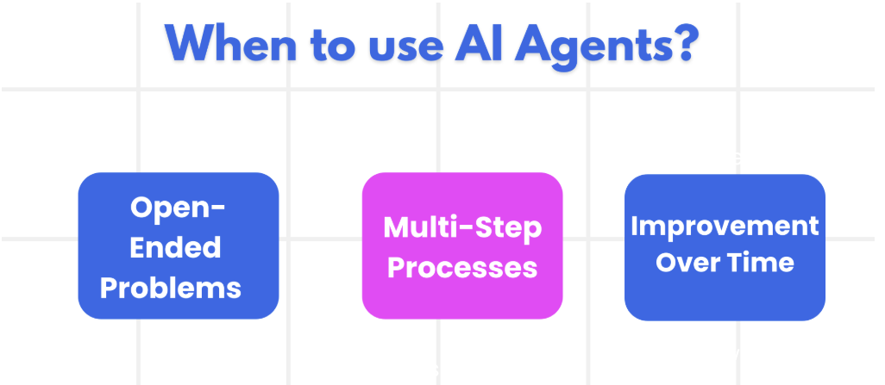
Starting point
The first step in designing an AI Agent system is to define the tools, actions, and behaviors.

Slide 15




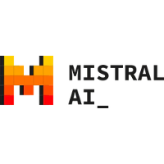


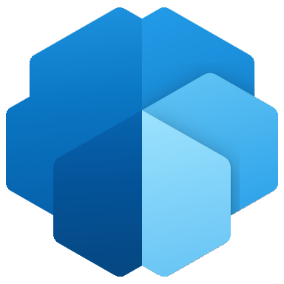
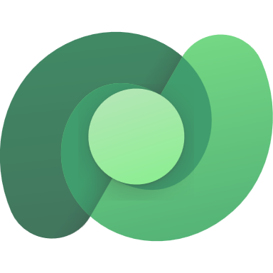
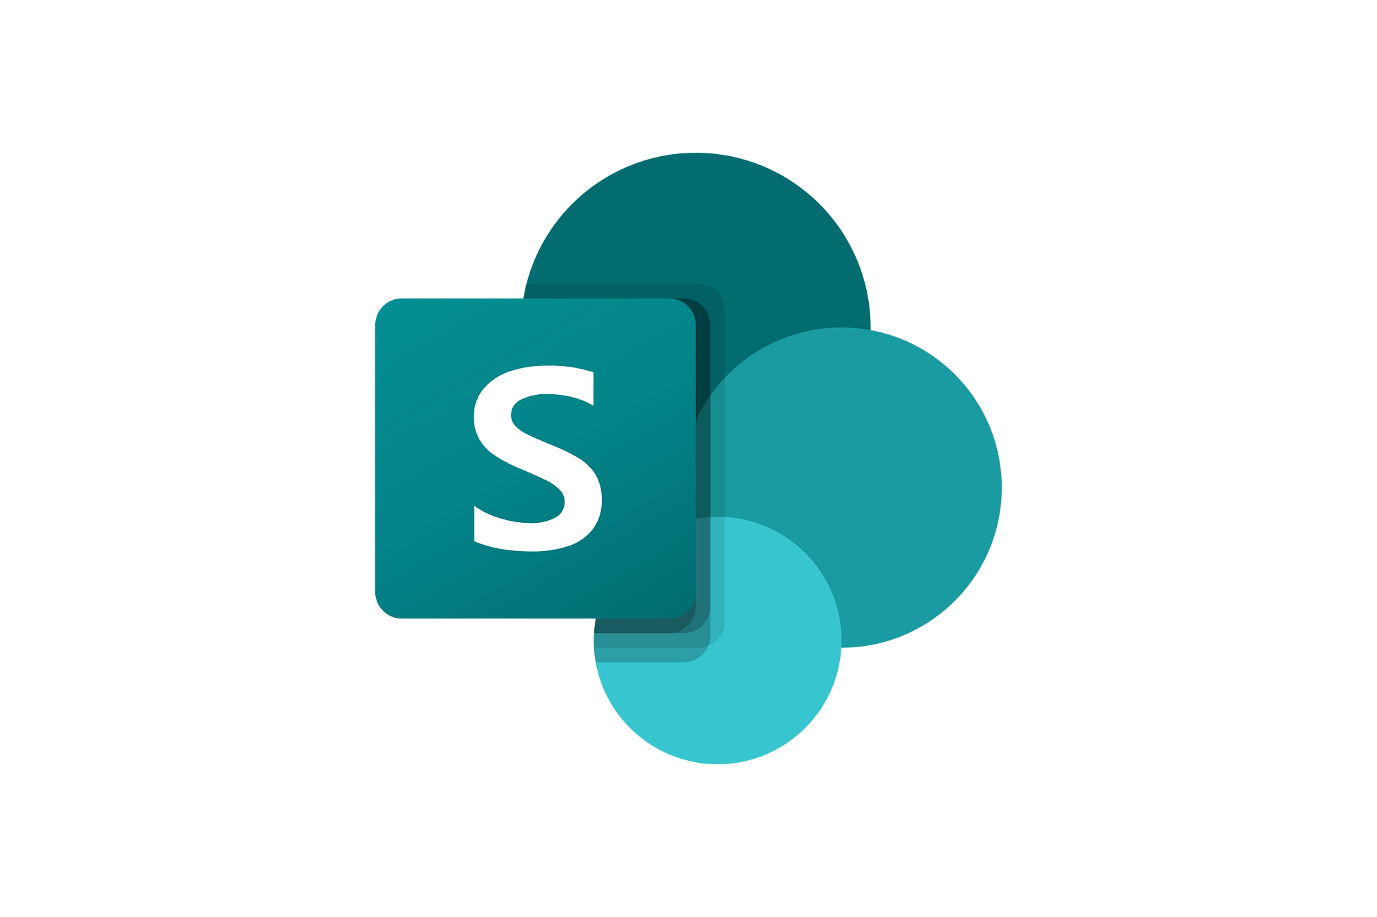
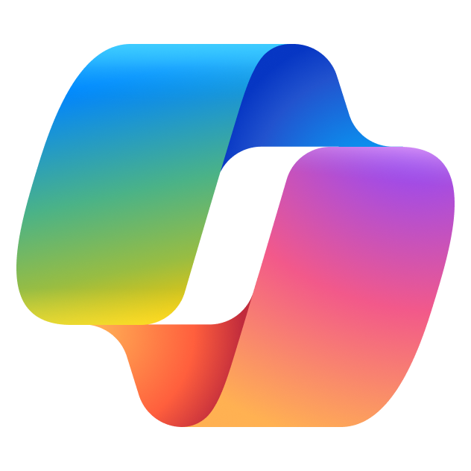




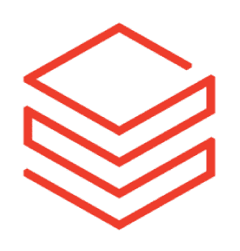
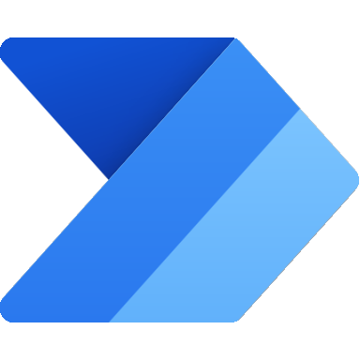


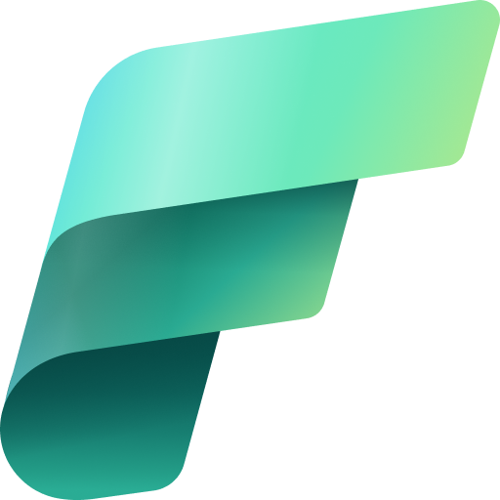

What is an Agent?
Models
Knowledge
Actions
Triggers
(Automation)

Slide 16
Generative AI makes apps truly intelligent
Intelligent apps
Natural language interaction
Data-driven, personalized experiences that improve over time
Quickly deliver new features
Modern apps
Modern app development principles
Microservices-based architecture
Rapid innovation with CI/CD

Slide 17
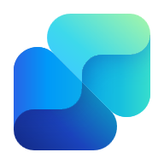

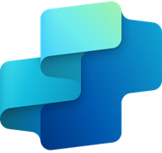

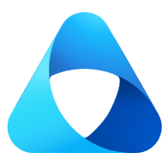
AI Alignment Guide
 | I want a generative AI solution
 | I want out-of-the-box solutions that work with my existing data estate for my employees |  |  |  |  | I want to build a solution with custom data and UI, and deploy internally or externally
 | I want insights and actions for specific roles that integrate with existing system |  | I want insights and actions on M365 data and plugins |  |  | I want to customize agents with natural languages and use a generative orchestrator |  |  | I want full control, choice of model, and customize with code
 | Persona-Based Copilots Enhance |  | Microsoft 365 Copilot Extend |  |  | Copilot Studio Integrate |  |  | Azure AI Foundry
Licensing | Per User |  | Per User* |  |  | PAYG or Capacity Pack |  |  | Azure Services Meters
Stories | Link | Link |  | Link | Link |  | Link | Link |  | Link
Persona | Line-of-Business Owner |  | Knowledge Worker |  |  | Power User |  |  | Developer
Out-of-box Value |  |  |  |  |  |  |  |  | ★
Customization | ★ |  | ★ |  |  |  |  |  | 
Enhance
Extend
Integrate
Integrate with Fabric + Purview
* Microsoft 365 Copilot Chat advanced Agent Capabilities requires Copilot Studio Messages
Notes:
Office 365 Copilot:
Integrated into Microsoft 365 applications like Word, Excel, Teams, and Outlook.
Helps users complete tasks by understanding natural language prompts.
Designed to boost productivity by automating repetitive tasks and providing intelligent suggestions directly within the apps.
Example in Insurance: An insurance agent can use Office 365 Copilot to draft personalized emails to clients, analyze large datasets to identify trends and opportunities faster, and summarize meetings and emails missed while on vacation.
Copilot Studio:
Part of the Microsoft Power Platform.
Allows you to create and customize your own AI copilots using low-code/no-code tools.
Enables the design of custom workflows, integration with various data sources, and creation of unique AI-driven experiences.
Example in Insurance: An insurance company can use Copilot Studio to create a custom AI assistant that helps underwriters evaluate potential and existing clients by reviewing all relevant information, such as health records and credit scores. This assistant can also help manage existing products and develop new ones to grow revenue.
Azure AI Foundry:
A more advanced platform for developing AI solutions.
Supports the creation of custom AI models, including natural language processing and computer vision.
Requires more technical expertise for building infrastructure, coding, and training models.
Ideal for organizations needing highly customized AI solutions with greater flexibility and customization.
Example in Insurance: An insurance company can use Azure AI Foundry to automate the processing of insurance claim forms. This solution can classify, extract, and summarize information from claim forms, significantly increasing the daily claim processing capacity and improving operational efficiency

Slide 18
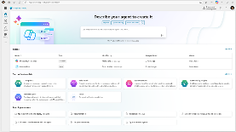
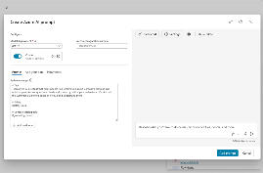
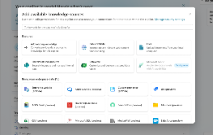
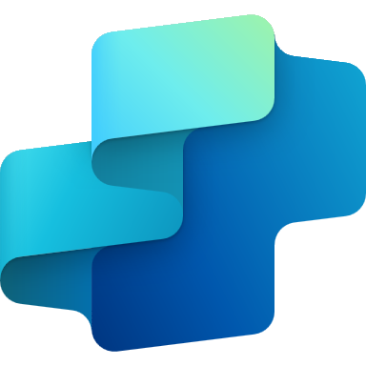
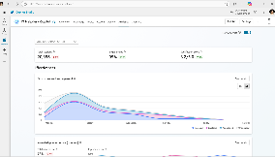
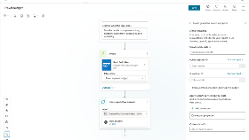
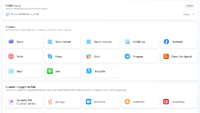
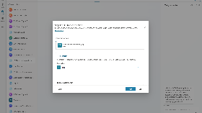
Agents + Copilot Studio
Design, enhance, and manage agents
Build an agent and go live quickly, all from one easy-to-use, E2E SaaS product
Integrate with AI services
Integrate with Azure AI Foundry, Azure Cog Services, Bot Framework and other Microsoft conversational services
Chat over knowledge with gen AI
Get enterprise-specific answers using your files, websites, Dataverse, third-party apps and more
Build & Publish
Monitor and improve Access rich out-of-the-box insights and analytics
Create specific topics
Supplement gen AI responses with specific, curated topics for when you want more control
Copilot Studio
Publish to multiple channels Publish in 20+ languages and deploy to your channel of choice with a single click, including Microsoft 365 Copilot
Build actions Create actions and use pre-built connectors or Power Automate to call your backends and APIs or complete long-running tasks
Analyze & Improve
Notes:
So there you have it – a complete E2E life cycle for designing, enhancing and managing agents from one, single unified SaaS based experience.

Slide 19

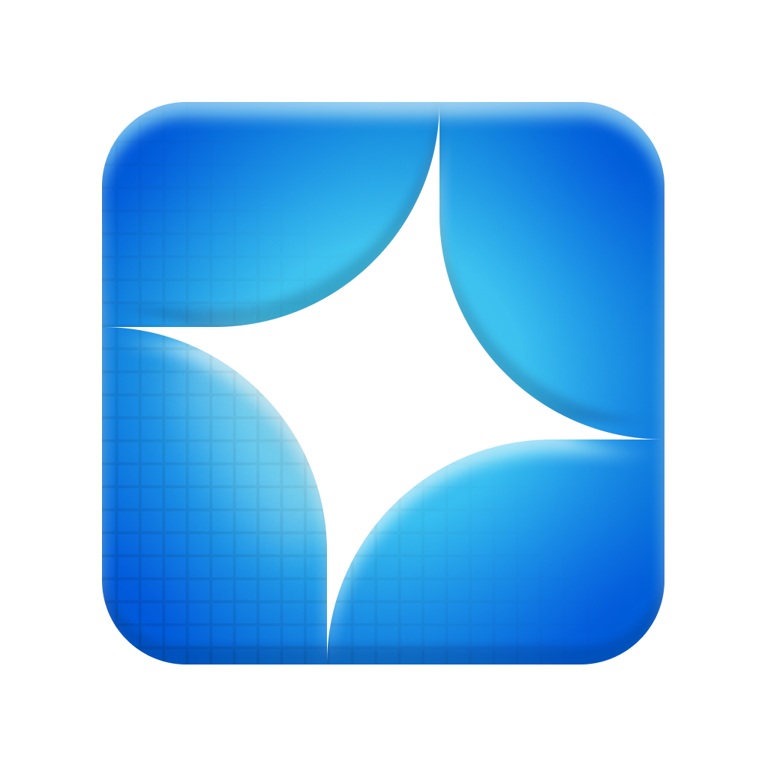











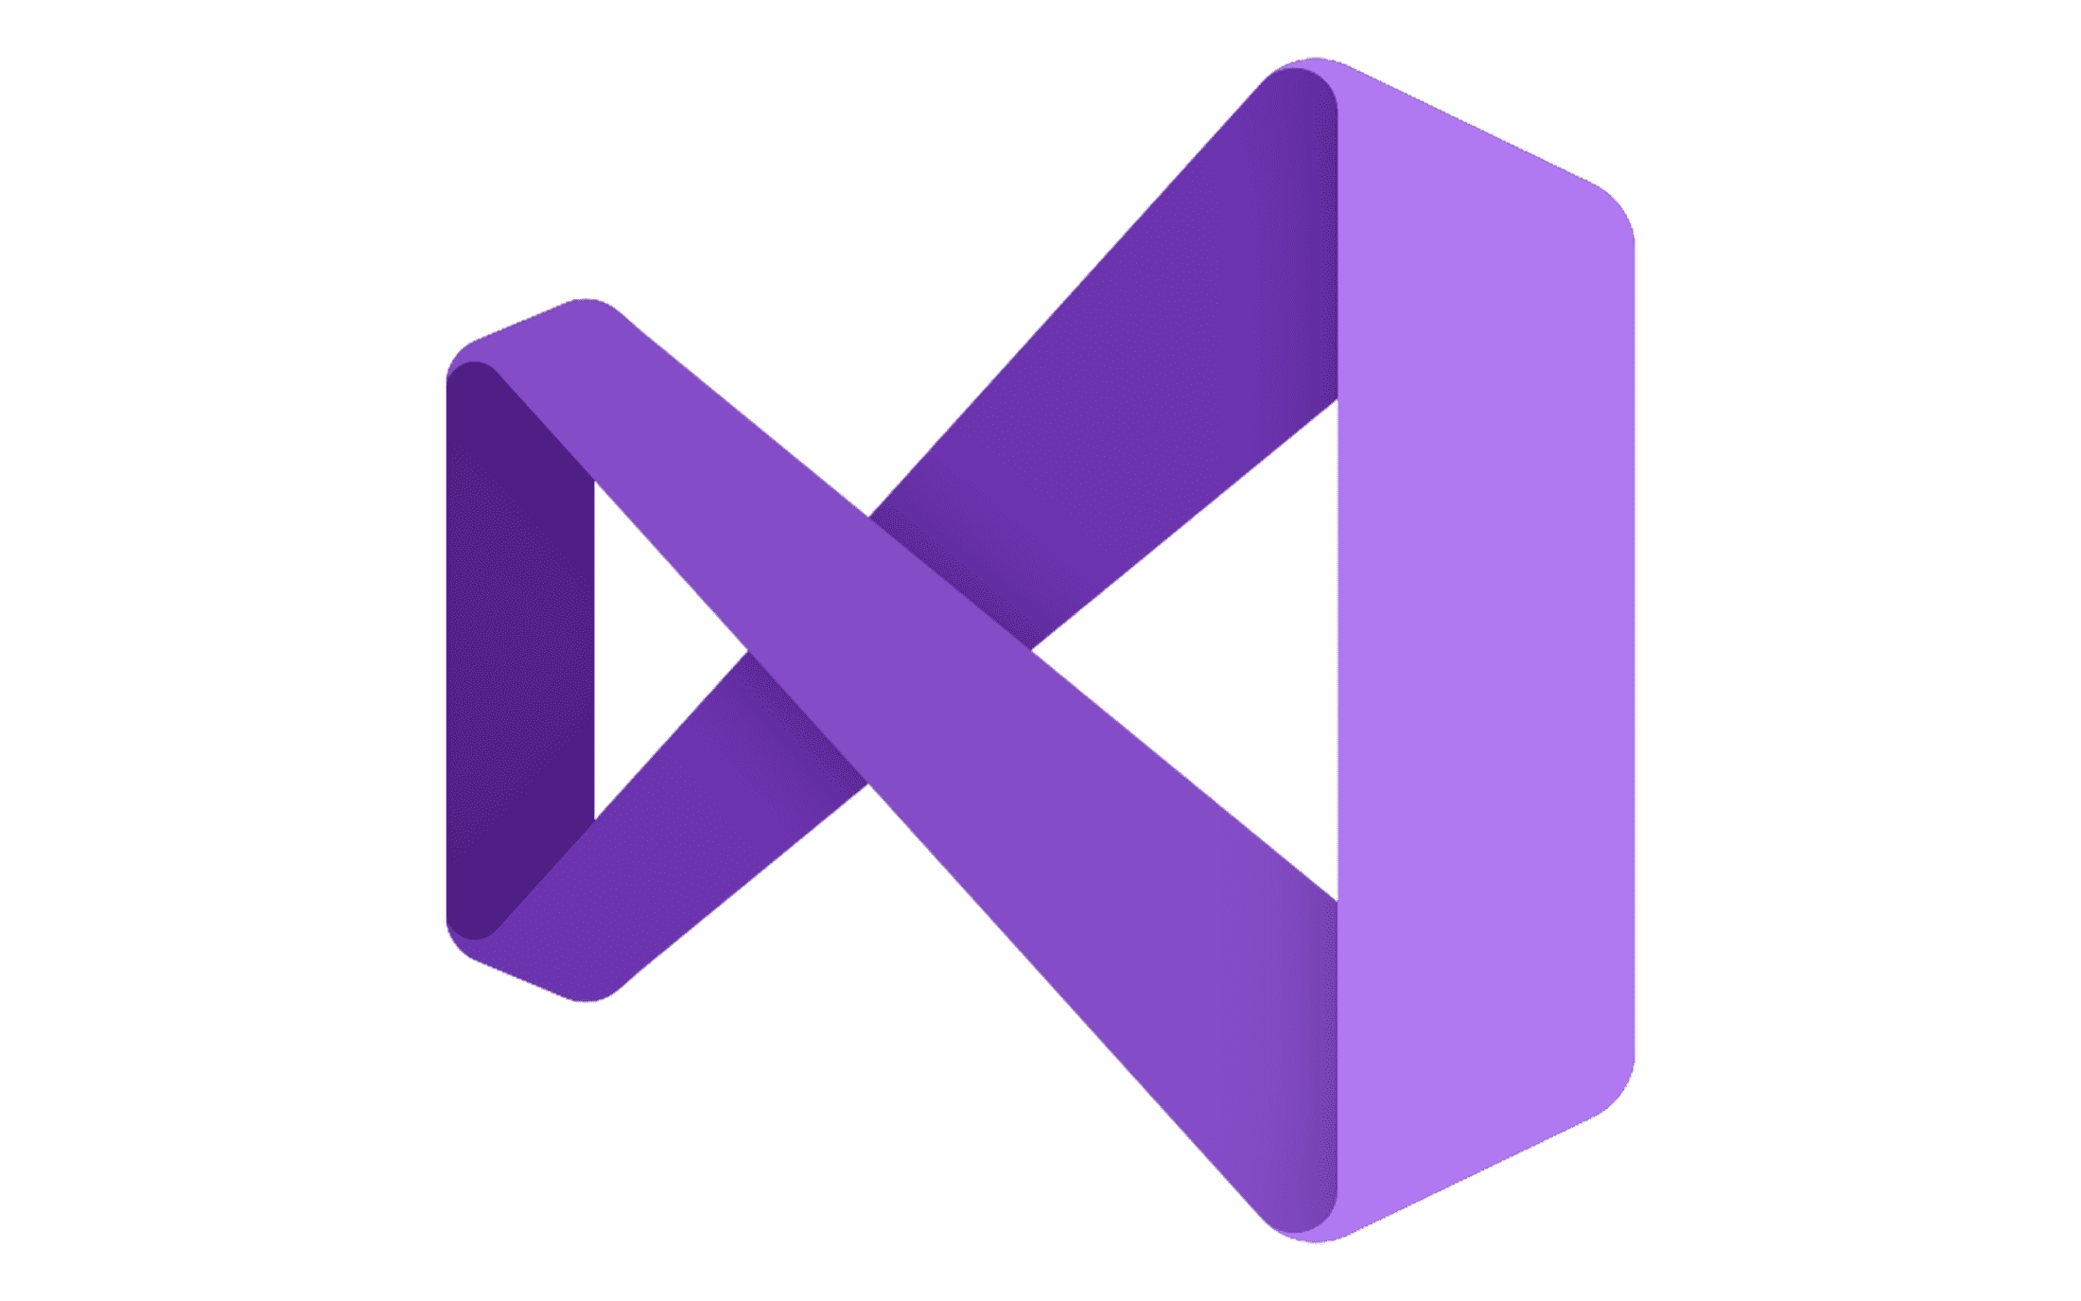
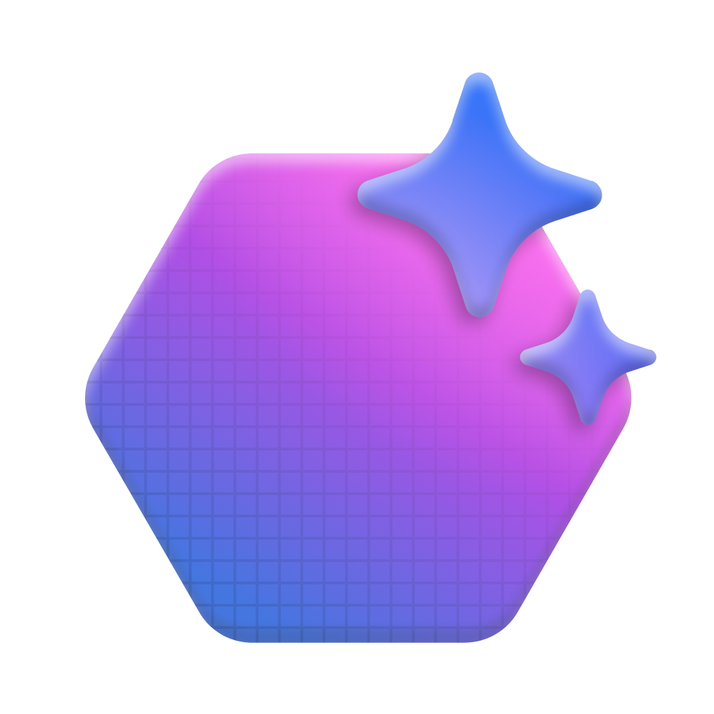



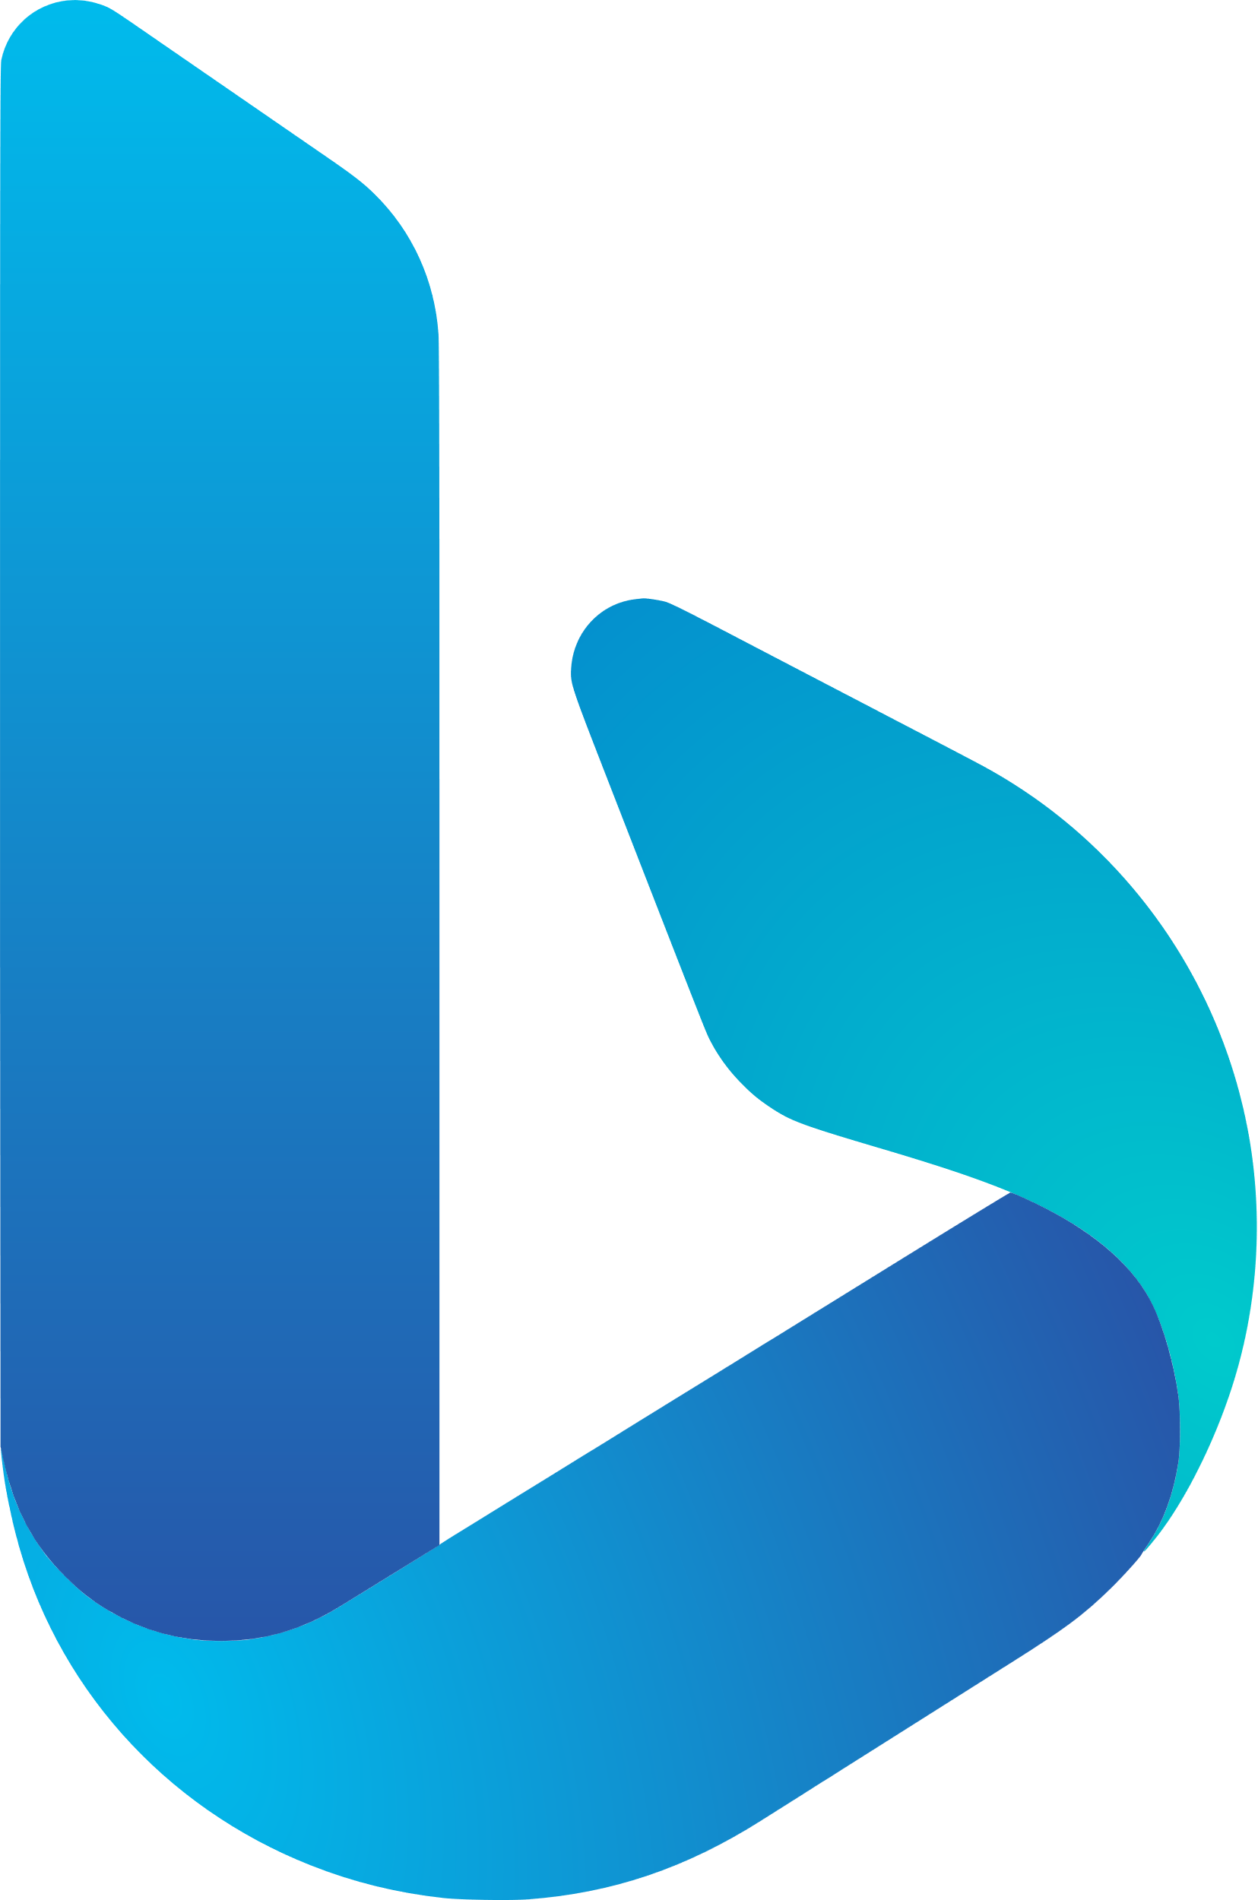

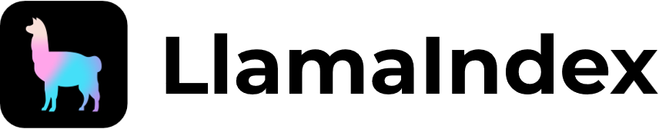







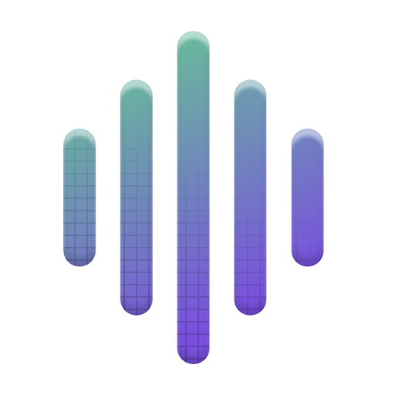


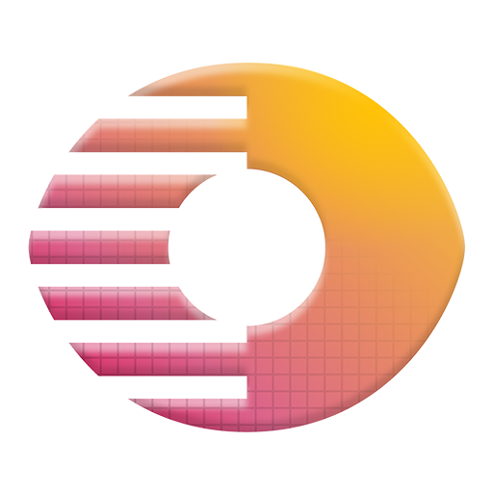
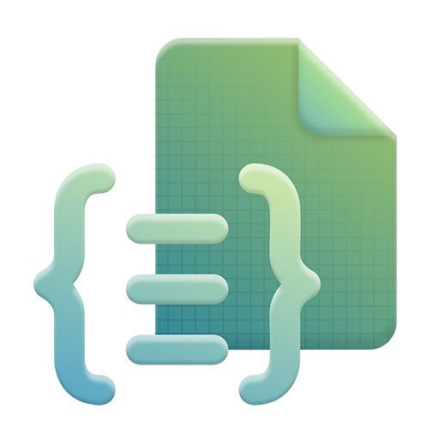
















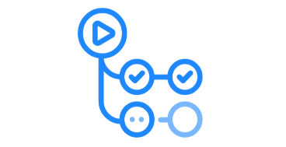



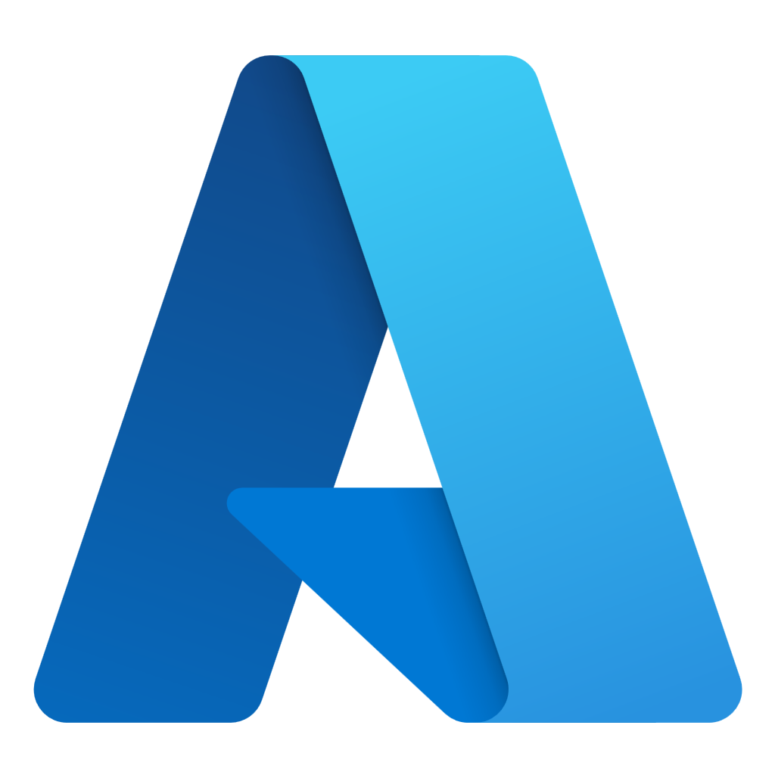


Azure AI Foundry agent ecosystem
Design with the best models
 | Azure OpenAI Service |  | Phi models |  | Jais G42 models |  | Snowflake models |  | Hugging Face models |  | Mistral AI models |  | Meta Llama models |  | Rockwell |  | Bayer
 | Cohere models |  | Databricks models |  | Nvidia models |  | Deci AI models |  | Nixtla TimeGen1 |  | NTT data model |  | Sight machine |  | Saifr |  | DeepSeek
Copilot Studio
Customize with a comprehensive agent toolchain
1P offerings |  |  |  |  |  |  |  |  |  |  |  |  |  | 3P offerings
 | Azure AI Agent Service |  | Azure AI Search |  | Microsoft Fabric |  | Azure SQL Database |  | Microsoft Bing |  | Microsoft Blob Storage |  | Microsoft SharePoint |  | Langchain |  | LlamaIndex
 | Azure Redis |  | Cosmos DB |  | Azure Data Lake Storage |  | Azure Logic Apps |  | Azure Functions |  | Event Hub |  | Dynamic Sessions |  | Llama Stack |  | Code Interpreter
 | Container Apps |  | Azure Kubernetes |  | Azure AI Speech |  | Azure AI Language |  | Azure AI Translation |  | Azure AI Vision |  | Azure AI Doc. Intelligence |  | OpenAI Actions |  | Gretel
 | Azure AI Content Und. |  | Semantic Kernel |  | AutoGen |  | Azure ML |  | Prompty |  | Fine-tuning & distillation |  | Tracing & debugging |  | Weights & Biases |  | Scale
 | Evaluation |  | Experiments |  |  |  |  |  |  |  |  |  |  |  | Statsig |  | Arize AI
Visual Studio
GitHub
Manage performance in production
 | Azure Monitor |  | Azure App Config |  | Microsoft Cost Management |  | ClearML |  | Dataloop |  | GitHub Actions
Azure AI Foundry SDK
Safeguard with Trusthworthy AI
 | Azure AI Content Safety |  | Microsoft Defender |  | Entra ID |  | Azure Policy |  | Azure Application Gateway |  | Azure Confidential Computing |  | Azure Backup

Slide 20
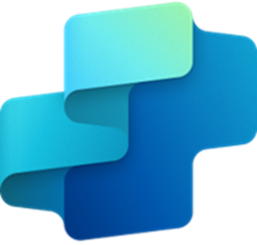

Copilot Studio + AI Foundry
Accessible Chatbot UI
Deployable Anywhere
Conversation Orchestration
Robust Security
Fully Managed SaaS
Copilot Studio
An integration capability allows customers to configure Copilot Studio to use their own model deployment in Azure AI Foundry for generative answers.
There are benefits to using both together as illustrated on the right.
Request for generative
answers
Generative
Answers
Guarantees Performance
Offers Scalability
Deploy custom models
+3,000 model catalog
GitHub & VS integration
Bring-your-own-Model
Azure AI Search
Copilot Studio + Azure AI Foundry
Azure AI Foundry
Notes:
Why Copilot Studio and Azure AI Foundry are Better Together:
When combined, Copilot Studio and Azure AI Foundry offer a powerful and flexible solution for developing and deploying AI applications. Here are some key benefits of using them together:
Seamless Integration: Copilot Studio can leverage the extensive catalog of AI models available in Azure AI Foundry, allowing you to create highly customized AI solutions that are grounded in cutting-edge technology[1].
Enhanced Customization: With the tools and services provided by Azure AI Foundry, you can fine-tune and optimize the AI models developed in Copilot Studio to ensure they meet your specific needs[1].
Scalability and Security: Azure AI Foundry's robust security and scalability features ensure that the AI solutions developed in Copilot Studio can be deployed and managed at scale, providing a reliable and secure environment for your AI applications[1].
Comprehensive Development Lifecycle: Together, Copilot Studio and Azure AI Foundry support the entire AI development lifecycle, from defining project goals to deploying and monitoring AI applications. This unified approach simplifies the development and management process, helping you focus on driving innovation and achieving strategic goals[1].
Copilot Studio:
Copilot Studio is a versatile platform that allows organizations to create custom AI copilots tailored to their specific needs. It provides tools for building, training, and deploying AI models, enabling businesses to develop solutions that address unique challenges. With Copilot Studio, you can:
Develop Custom AI Solutions: Create AI copilots that are specifically designed to meet your organization's requirements.
Extensibility: Integrate with various applications and services to provide seamless assistance across different platforms.
Modern Customization Models: Utilize modern customization options to enhance the functionality and user experience of your AI solutions[1].
Azure AI Foundry:
Azure AI Foundry is a comprehensive platform for developing, testing, and deploying AI solutions. It offers a wide range of AI models, tools, and services, including Azure OpenAI, Azure AI services, and Azure AI Search. With Azure AI Foundry, you can:
Access a Robust Catalog of AI Models: Leverage a growing catalog of frontier and open-source models from OpenAI, Hugging Face, Meta, and more[1].
Security and Scalability: Benefit from robust security, scalability, and integration with other Azure services[1].
Development Tools: Utilize development tools for building and customizing AI applications, including reusable components like datasets, models, and indexes[1].
Fine-Tuning Models: Fine-tune models to meet specific needs, ensuring that the AI solutions are tailored to your requirements[1].
Conclusion:
In summary, Copilot Studio and Azure AI Foundry are better together because they offer a seamless, flexible, and scalable solution for developing and deploying AI applications. By combining the strengths of both platforms, you can create highly customized AI solutions that drive innovation and efficiency in your organization.
I hope this explanation helps you understand the benefits of using Copilot Studio and Azure AI Foundry together. If you have any questions or would like to see a demo, please let me know. Thank you for your time, and I look forward to helping your organization harness the power of AI.
Feel free to customize this script to better fit your specific needs and audience. Let me know if there's anything else I can assist you with!
References
[1] Build your own copilot with Microsoft Azure AI Studio | Microsoft Azure Blog

Slide 21
Executing hack - options
NOTE: You don’t need E5 and Azure subscriptions in a single Tenant for executing these challenges.
az login --tenant <<tenant id>> - If you have multiple subscripts in a tenant, please select appropriate one.
Challenges | Env – Tenant/Subs | Additional details
Ch1 - Copilot studio | External tenant or CDX Known issue – Email trigger/AI Search index doesn’t work in Internal tenant. Coach should demo this. | E5, if you are using AI search index or email trigger option, then you will have DLP blocking issues in internal copilot studio preview env.
Ch2 – Foundry UI | Internal Microsoft non-prod, External tenant | Option 2 & 3 - Github CodeSpace or local applies to CH3
Ch3 – Code first Run locally | Internal Microsoft non-prod | Use appropriate login options – a) browser-based b) Service principal. Change the path and update the env file, select appropriate python version >3.10, make sure all python pkg installed etc..
Ch3 – Code first Run in github code space | Internal Microsoft non-prod, External | Use appropriate login options – a) browser-based b) Service principal
Ch3 – Code first Run locally with dev container + docker env | Internal Microsoft non-prod, External | Use appropriate login options – a) browser-based b) Service principal

Slide 22
Welcome & Introduction | 10 mins | 11:00 – 11:10 A.M. (EST)
Setting the Stage | 40 mins | 11:10 – 11:50 A.M. (EST)
Lunch | 30 mins | 11:50 – 12:20 P.M. (EST)
Hands-On Hack | 60 mins | 12:20 – 1:20 P.M. (EST)
Break | 10 mins | 1:20 – 1:30 P.M. (EST)
Hands-On Hack | 60 mins | 1:30 – 2:30 P.M. (EST)
Show & Tell | 45 mins | 2:30 – 3:15 P.M. (EST)
Close | 15 mins | 3:15 – 3:30 P.M. (EST)

Slide 23
Hands-On Hack
3

Slide 24
Agenda
Welcome & Introduction | 10 mins | 11:00 – 11:10 A.M. (EST)
Setting the Stage | 40 mins | 11:10 – 11:50 A.M. (EST)
Lunch | 30 mins | 11:50 – 12:20 P.M. (EST)
Hands-On Hack | 60 mins | 12:20 – 1:20 P.M. (EST)
Break | 10 mins | 1:20 – 1:30 P.M. (EST)
Hands-On Hack | 60 mins | 1:30 – 2:30 P.M. (EST)
Show & Tell | 45 mins | 2:30 – 3:15 P.M. (EST)
Close | 15 mins | 3:15 – 3:30 P.M. (EST)
GitHub: https://github.com/Boykai/octo-microhack-agentic-ai

Slide 25
Break
4

Slide 26
Agenda
Welcome & Introduction | 10 mins | 11:00 – 11:10 A.M. (EST)
Setting the Stage | 40 mins | 11:10 – 11:50 A.M. (EST)
Lunch | 30 mins | 11:50 – 12:20 P.M. (EST)
Hands-On Hack | 60 mins | 12:20 – 1:20 P.M. (EST)
Break | 10 mins | 1:20 – 1:30 P.M. (EST)
Hands-On Hack | 60 mins | 1:30 – 2:30 P.M. (EST)
Show & Tell | 45 mins | 2:30 – 3:15 P.M. (EST)
Close | 15 mins | 3:15 – 3:30 P.M. (EST)

Slide 27
Show & Tell
5

Slide 28
Agenda
Welcome & Introduction | 10 mins | 11:00 – 11:10 A.M. (EST)
Setting the Stage | 40 mins | 11:10 – 11:50 A.M. (EST)
Lunch | 30 mins | 11:50 – 12:20 P.M. (EST)
Hands-On Hack | 60 mins | 12:20 – 1:20 P.M. (EST)
Break | 10 mins | 1:20 – 1:30 P.M. (EST)
Hands-On Hack | 60 mins | 1:30 – 2:30 P.M. (EST)
Show & Tell | 45 mins | 2:30 – 3:15 P.M. (EST)
Close | 15 mins | 3:15 – 3:30 P.M. (EST)

Slide 29
Instructions:
Each team will have 5 minutes to share their topics.
Make sure that everyone speaks
Make sure that everyone is on camera when they are speaking
There are no wrong answers and no penalty for not having finished (but we would love to know what held you back from finishing)
Topics to Share for Show & Tell:
Name one thing you learned
What was more difficult than you expected?
What surprised you the most?
What do you think will be the biggest pushback from your customer as they look to adopt this technology?
Did you have any showstoppers?

Slide 30
Close
6

Slide 31
Agenda
Welcome & Introduction | 10 mins | 11:00 – 11:10 A.M. (EST)
Setting the Stage | 40 mins | 11:10 – 11:50 A.M. (EST)
Lunch | 30 mins | 11:50 – 12:20 P.M. (EST)
Hands-On Hack | 60 mins | 12:20 – 1:20 P.M. (EST)
Break | 10 mins | 1:20 – 1:30 P.M. (EST)
Hands-On Hack | 60 mins | 1:30 – 2:30 P.M. (EST)
Show & Tell | 45 mins | 2:30 – 3:15 P.M. (EST)
Close | 15 mins | 3:15 – 3:30 P.M. (EST)

Slide 32
Thank YOU!
Do not forget to Clean Up environment resources.

Slide 33


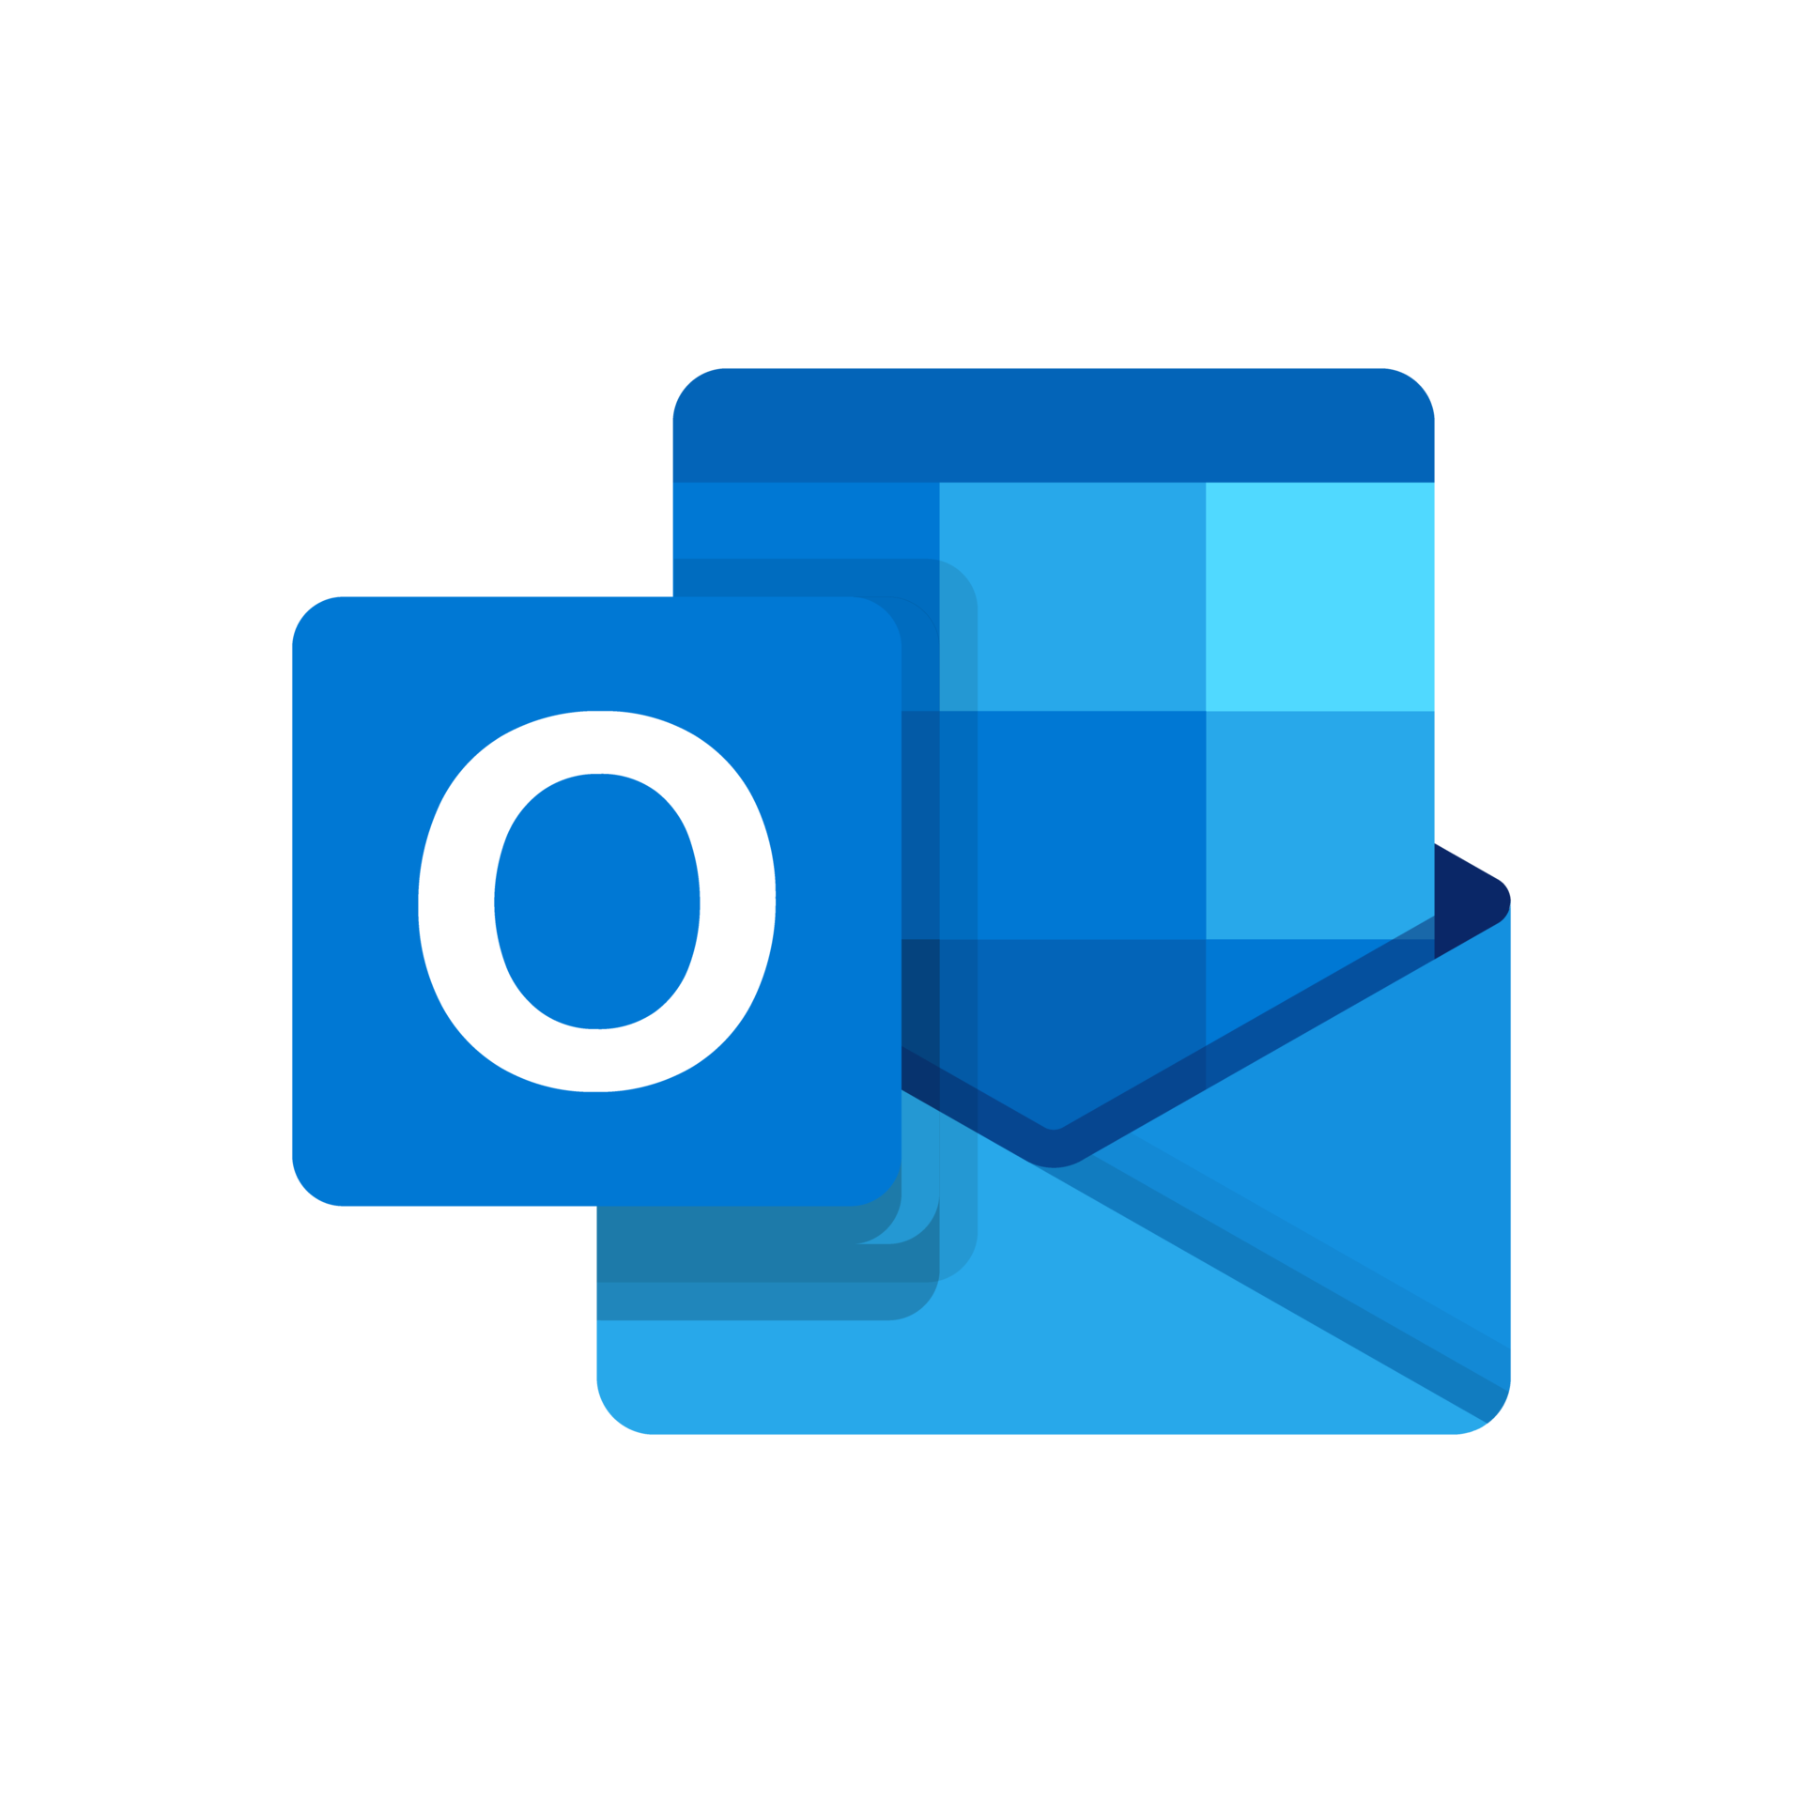

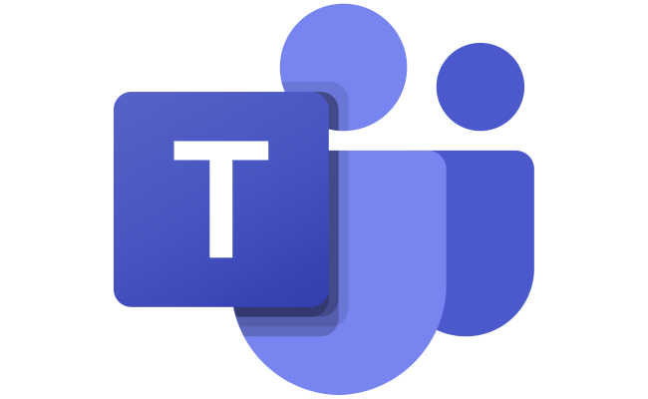
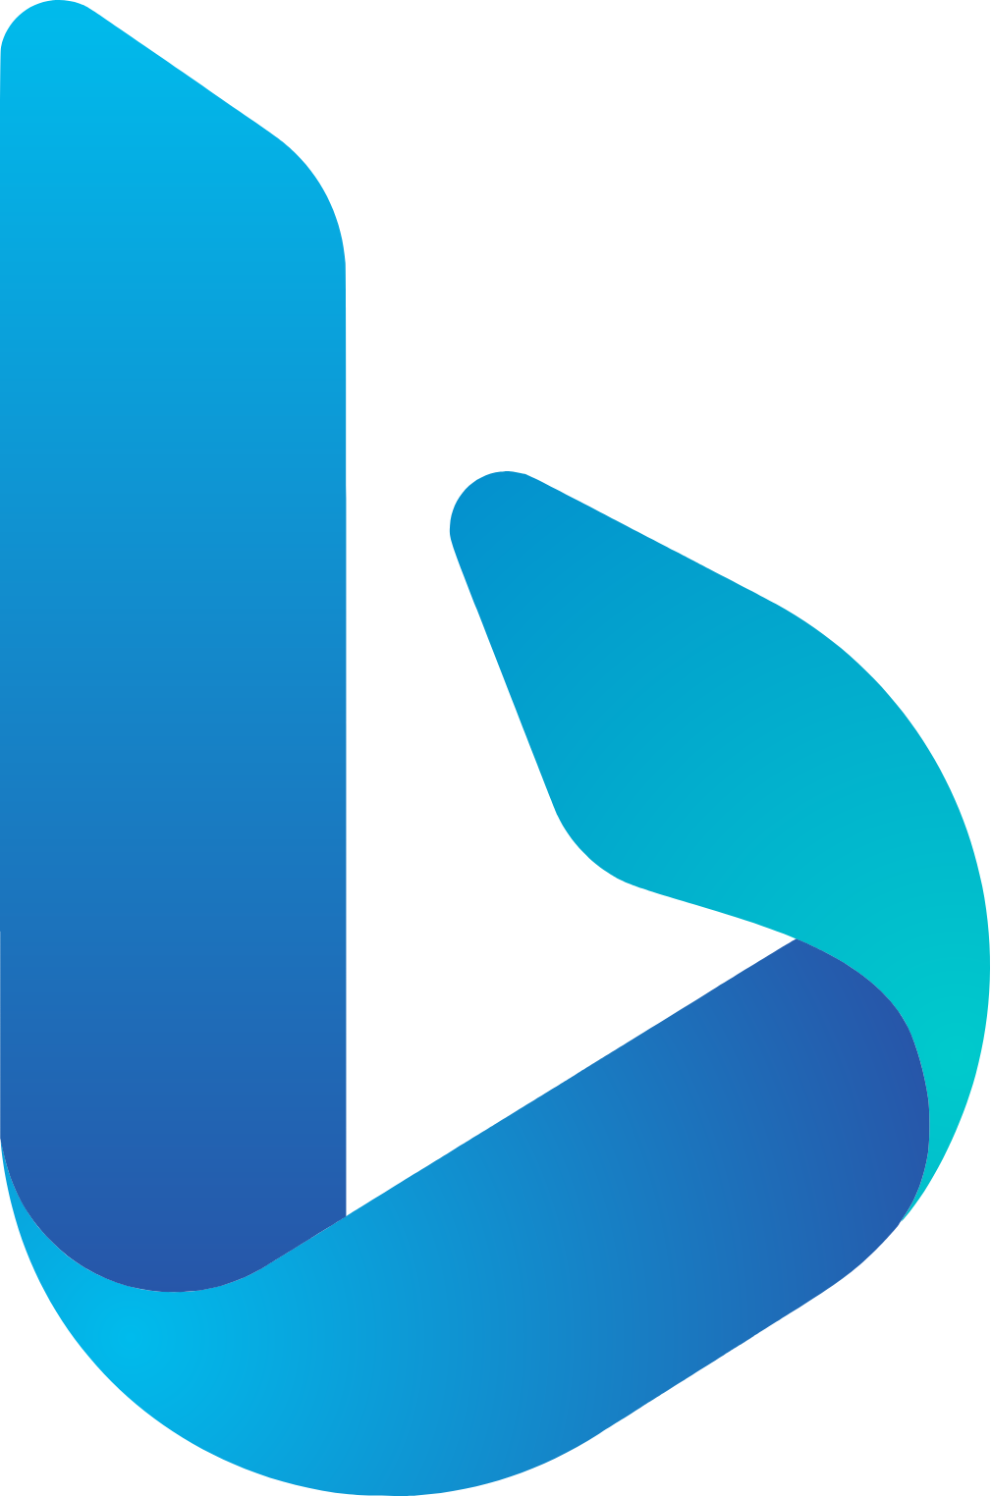

Copilot Studio Architecture
Knowledge Base
User
Outlook
Email
Content
Safety
Copilot Model
Content
Safety
Teams
User
Bing Web
Copilot Studio

Slide 34
Azure AI Foundry Architecture
Knowledge Base
User
Content
Safety
GPT-4o Model
Content
Safety
User
Bing Web
Azure AI Foundry

Slide 35

Azure AI Foundry Architecture
SQL DB
Knowledge Base
User
VS Code
Content
Safety
GPT-4o Model
Content
Safety
User
Bing Web
Azure AI Foundry

